Slide 1


AI Sales
Chatbot

Slide 2


Table Of Contents
01. Problem Statement
02. Our Solution
03. System Architecture
04. Demo

Slide 3

Problem Statement
Current Challenges
Enhancing Customer Service Efficiency
Personalized Experience
long wait times, high costs, inconsistent service.
Leads to poor customer satisfaction and loyalty
General advice reduces cross-selling, up-selling, and perceived value
Managing High Inquiry Volumes
Providing Real-time Guidance
High volume strains resources, delays responses, and increases errors
Delayed advice leads to missed opportunities and lower satisfaction

Slide 4



Our Solution
AI Sales Chatbot using Advanced techniques to understand Clients needs and fulfil it based on Banque Data integrated with many tools to enhance User Experiences.

Slide 5

Recommendation System &
Ai Sales Agent?

Slide 6
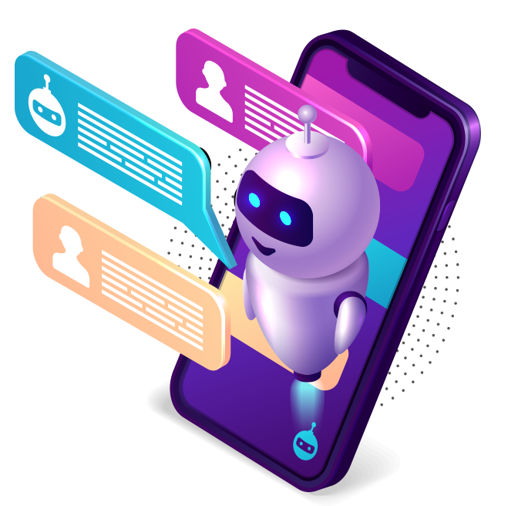
Recommendation System
An algorithm-based tool that analyzes user behavior, preferences, and interactions to suggest products, services, or content that the user might find valuable.
AI Sales Agent
An AI-driven virtual assistant that engages with customers in real-time. In banking, it guides customers through product selection and purchasing, driving sales and improving satisfaction. based on content (Products and FAQs).

Slide 7


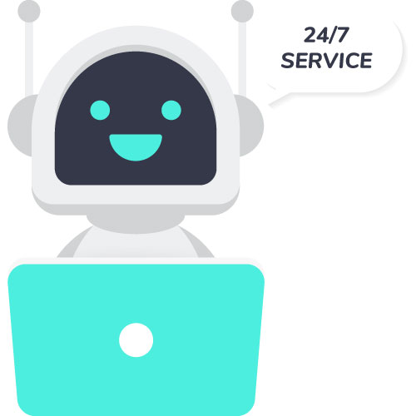



Why Do We Need Them?
Personalization
Efficiency and Cost Reduction
Availability
Data-Driven Decision Making
Compliance & Risk Management
Increase Sales & Revenue

Slide 8

How
Recommendation System & AI Sales Agent
benefits the organization
80%
of Netflix content streamed is driven by its
Recommendation System.

Slide 9

How
Recommendation System & AI Sales Agent
benefits the organization
35%
of Amazon’s total sales are driven by its Recommendation Engine.

Slide 10


How
Recommendation System & AI Sales Agent
Benefits Banks
70%
total sales in certain regions are driven by its “Next Best Action”
Recommendation system.

Slide 11

How
Recommendation System & AI Sales Agent
Benefits Banks
15%
higher conversion rate for Citi Bank customers who interacted with
Personalized Recommendations.

Slide 12
Let The Fun Begin !

Slide 13

Natural Language Understanding
Lack of Contextual Understanding
Emotional Intelligence
Handling Complex Queries
Challenges
Lack of Creativity and Empathy

Slide 14
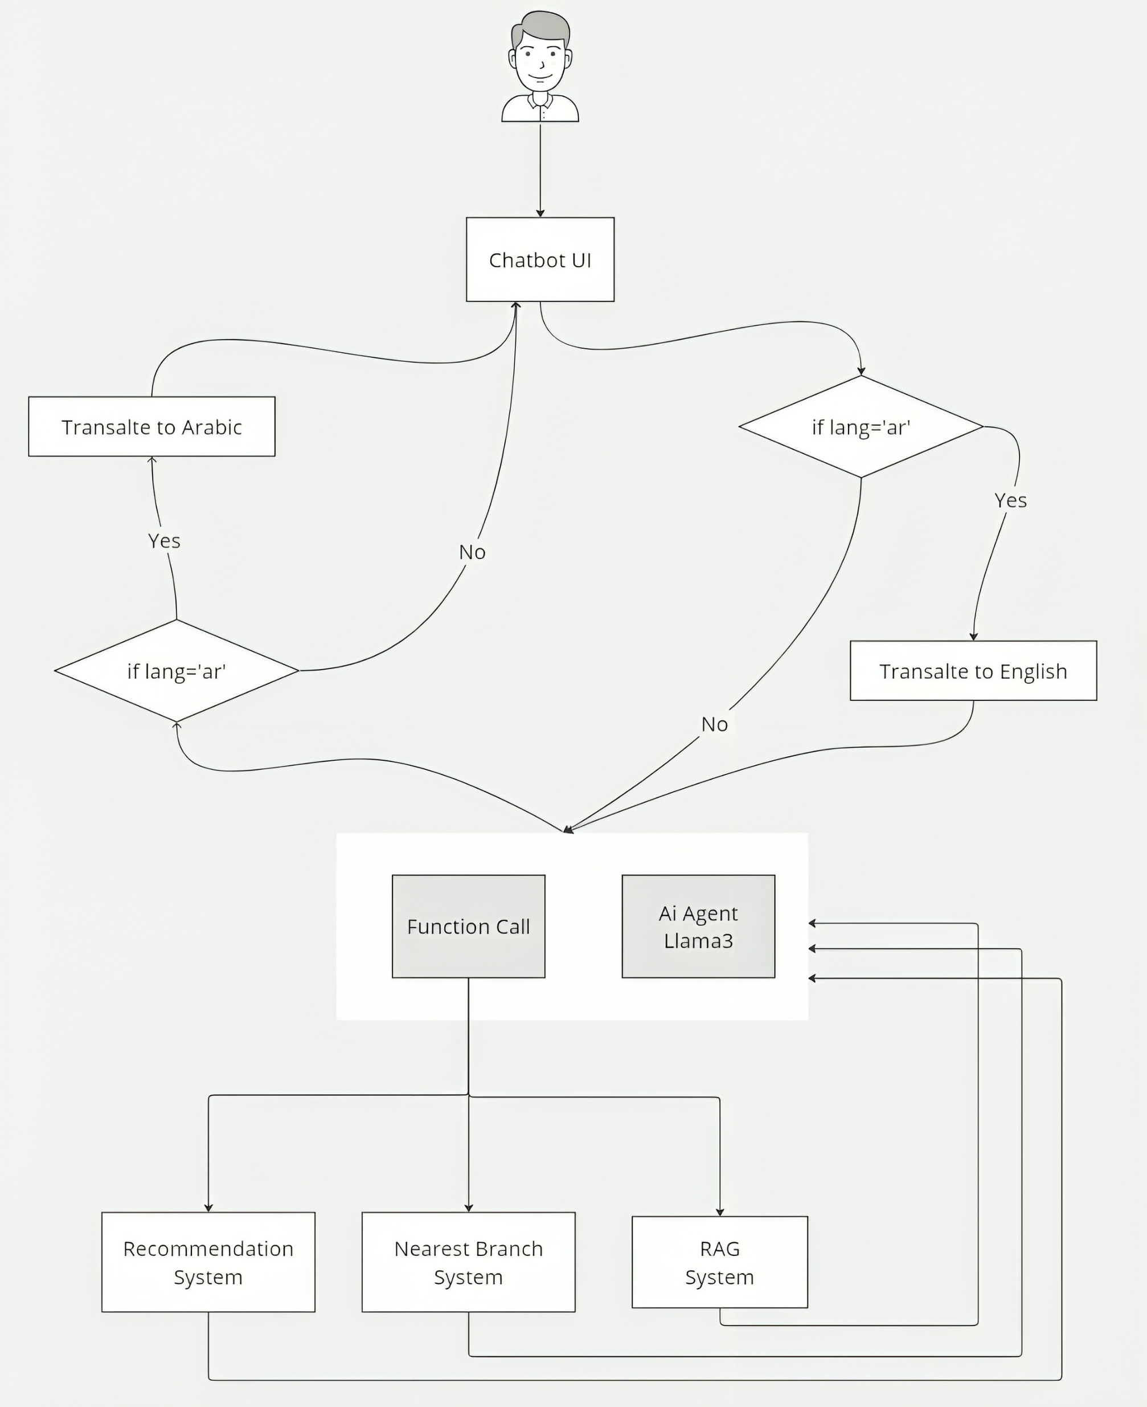
AI Chatbot
Structure.
Chat UI
Chat Translation
Recommendation system
Get Nearest branch
RAG Search
Function call Agent
Ai Agent Llama3

Slide 15

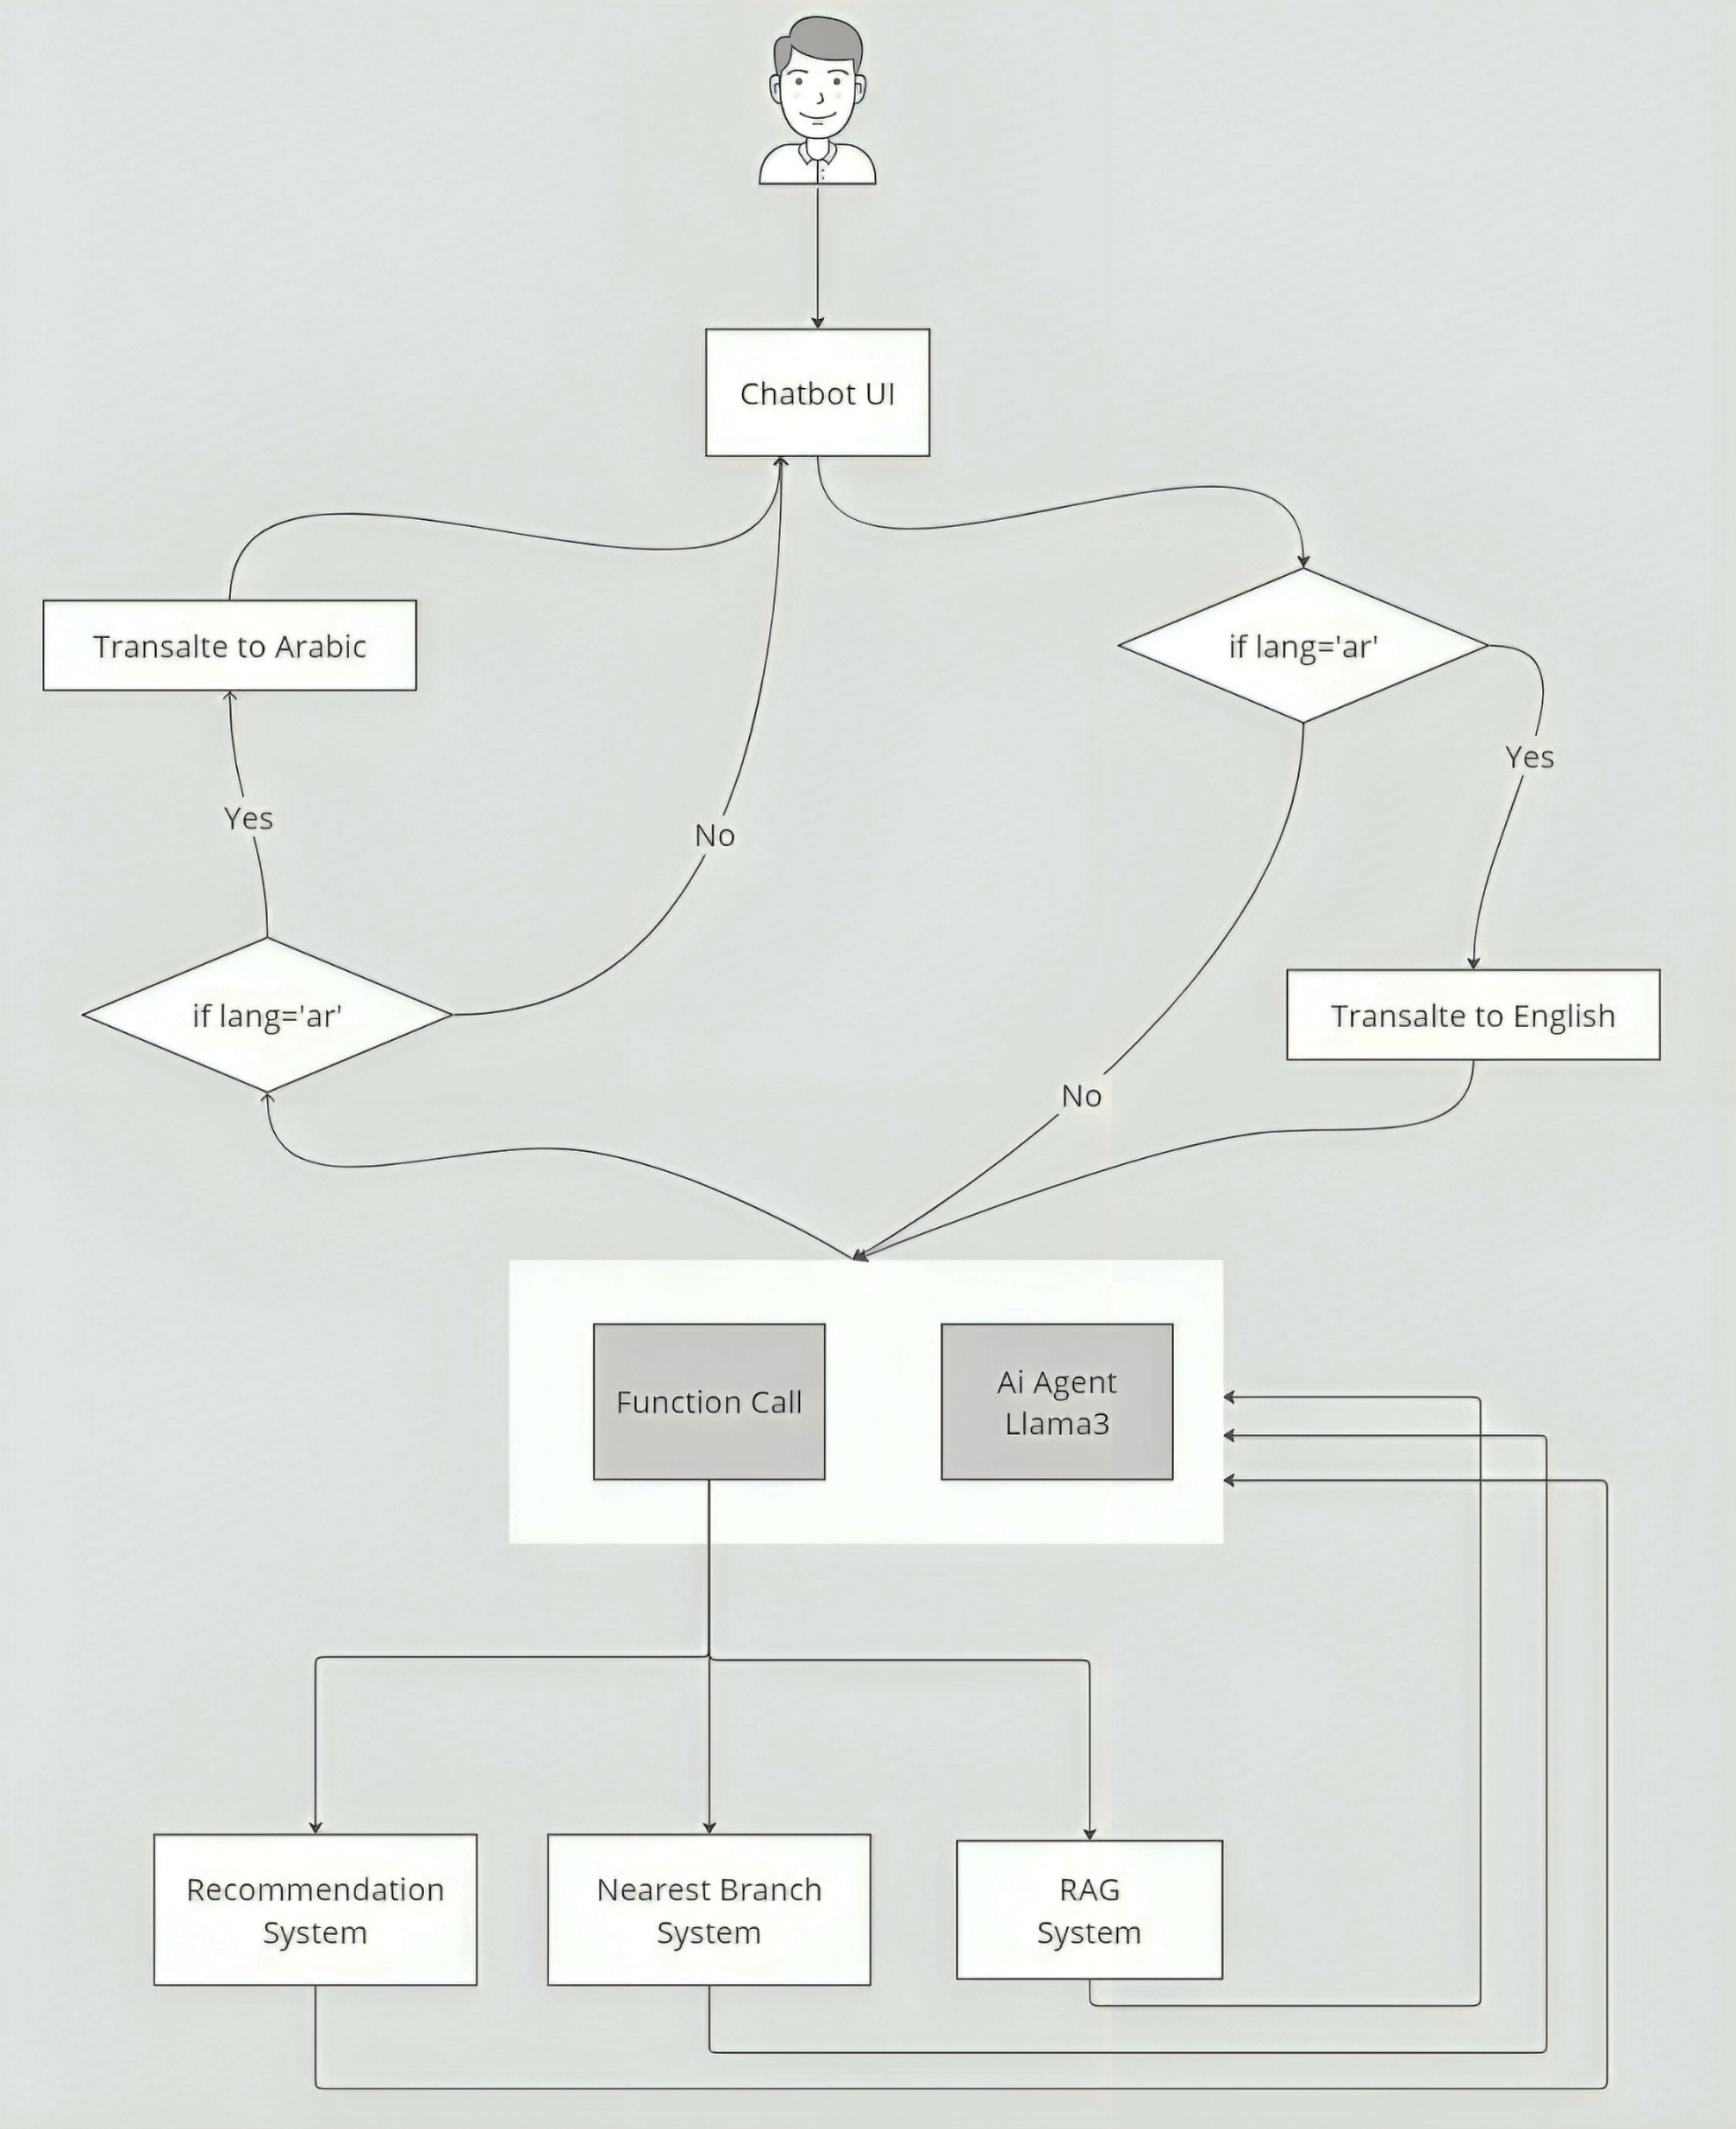
AI Chatbot.
1. Chat UI
Streamlit Library
Web-Based
Responsive

Slide 16
AI Chatbot.
2. Chat Translation
Deeper Translator Library
Translate Client Message

Slide 17
AI Chatbot.
3. Recommendation system
item-based Collaborative Filtering
Using K-Nearest Neighbors model
Dataset
Santander Product Recommendation
Our Ready to Use Python Tool

Slide 18

AI Chatbots.
4. Get Nearest branch
Google Maps Library
to get all Bank Branches locations
Geopy Library
to calculate Earth Distance
Get Deal Done Faster !

Slide 19
AI Chatbot.
5. RAG Search
Retrieval-Augmented Generation (RAG)
Chroma DB Library
Information Types
Bank Products
FAQs
Get Most relevant information for User Query
Contextually appropriate Answers

Slide 20
AI Chatbot.
6. Function call Agent
Nexus Raven2 Model from Nexusflow
Fine-Tuned from CodeLlama
Intelligently interprets User Query
Call Suitable Function to Fulfil User Needs

Slide 21
AI Chatbot.
7. Ai Agent Llama3
Llama 3 LLM Model from Meta
Open-Source
Groq API
With LPU for highest LLM inference
Provide User-friendly Answer
Based on Return of whatever Function Called

Slide 22
Our
AI Sales Chatbot
Is Ready to Use

Slide 23
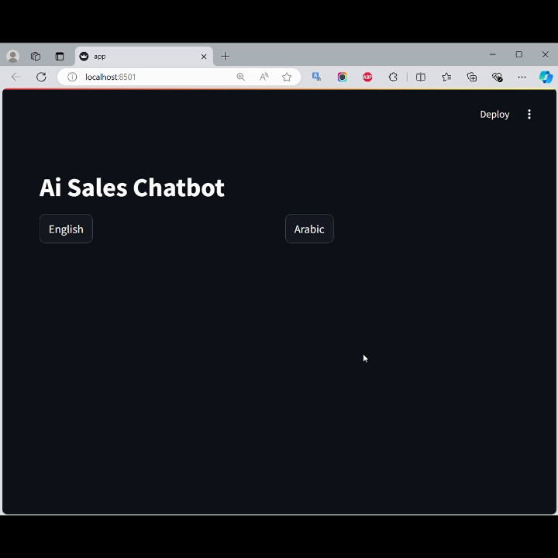
Ai Sales Agent Arabic Demo

Slide 24

Is this The End?
Our Horizons are wide

Slide 25




What Next?
Put Branch Load in Consideration While Choosing Nearest Branch
Expand the chatbot’s functionality beyond Products and FAQs
AI voice assistant
Customer Satisfaction
from chat conversations

Slide 26
Any Questions?

Slide 27
Thank You

